Slide 1
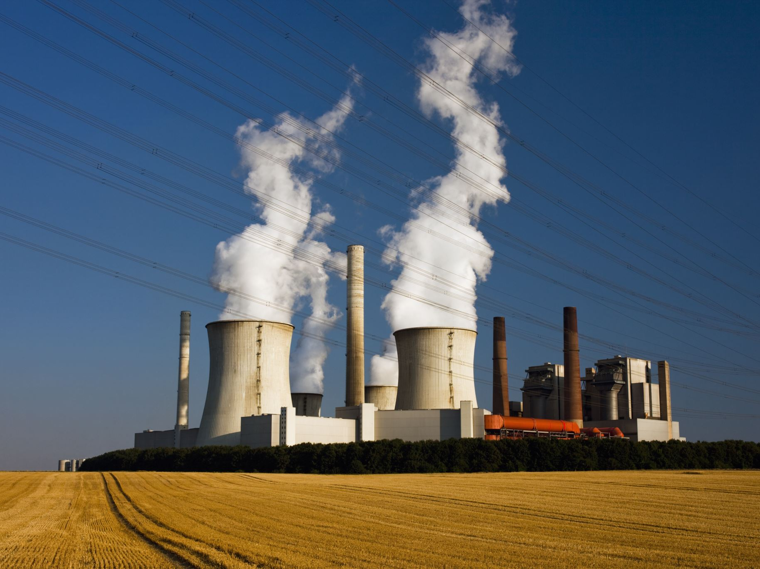
Tech Giants and Nuclear Energy
How Big Tech is Turning to Nuclear Power for Sustainability

Slide 2
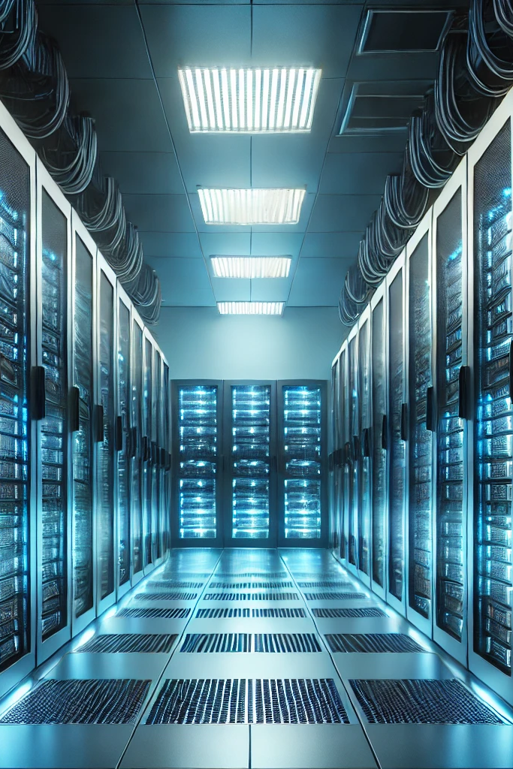
Introduction
Tech companies require more energy than ever.
AI, cloud computing, and data centers drive demand.
Traditional energy sources are not sufficient.
Notes:
Good morning everyone,
Today, I want to discuss a major shift happening in the tech industry—how digital giants like Microsoft, Oracle, and Amazon are turning to nuclear energy to power their ever-growing needs. With the rise of artificial intelligence, cloud computing, and massive data centers, energy consumption in the tech sector has skyrocketed. Traditional energy sources are struggling to keep up, leading these companies to explore nuclear power as a reliable and sustainable solution.

Slide 3

The Energy Challenge
Data centers consume about 1% of global electricity.
Energy needs will increase with AI advancements.
Renewable sources are useful but not always reliable.
Notes:
The digital revolution is fueled by data, and data needs energy. Data centers worldwide consume about 1% of global electricity, and this number is expected to rise dramatically with AI-driven services. These facilities require constant power, and renewable sources like wind and solar, while crucial, are not always reliable. This is where nuclear energy comes in—a source that provides steady, carbon-free electricity.

Slide 4
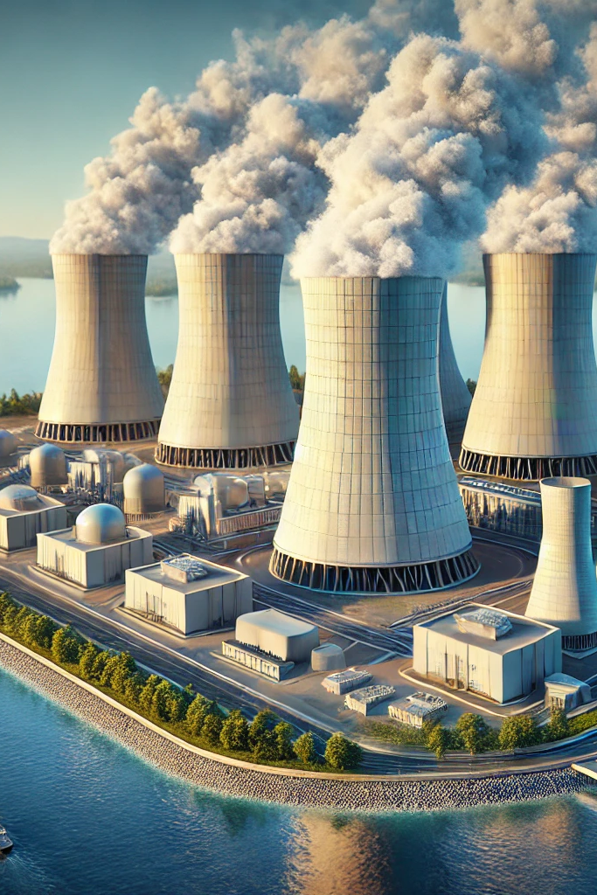
Microsoft and Three Mile Island
Microsoft is investing in nuclear energy.
Plans to reopen Unit 1 of Three Mile Island.
Aiming for long-term, low-carbon energy solutions.
Notes:
One of the most striking examples of this shift is Microsoft’s decision to invest in the revival of nuclear plants. Recently, the company announced plans to reopen Unit 1 of the Three Mile Island nuclear plant in Pennsylvania, which had been shut down since 2019. This marks a significant move for the industry, as it signals a commitment to long-term, low-carbon energy solutions.

Slide 5
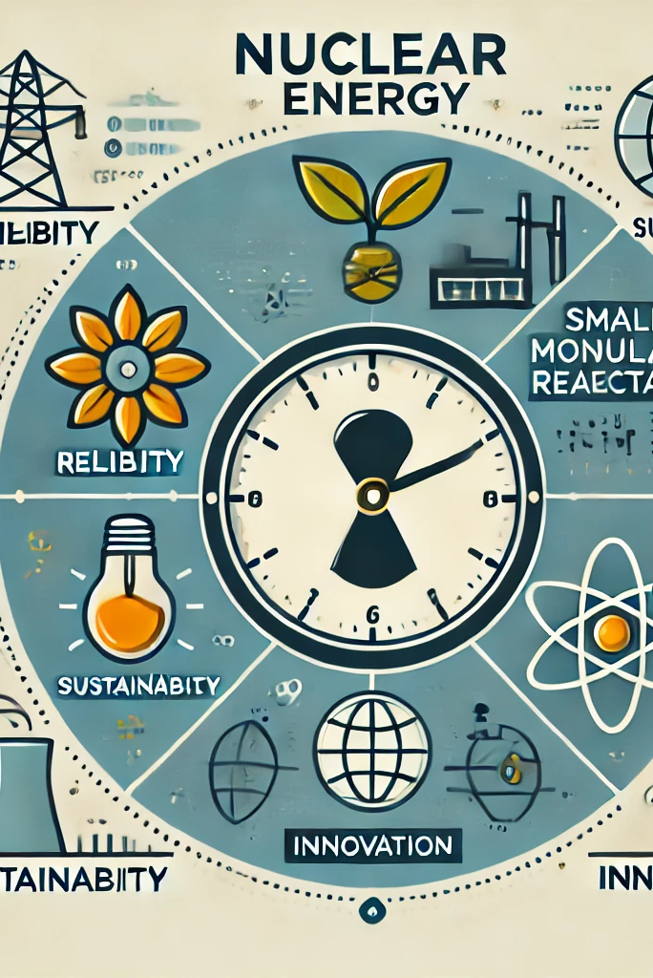
Why Nuclear?
Reliability: Stable power supply 24/7.
Sustainability: Carbon-free energy source.
Innovation: Small modular reactors (SMRs) offer new possibilities.
Notes:
Tech giants are choosing nuclear power for several reasons:
Reliability – Unlike solar or wind, nuclear provides a stable power supply, essential for running data centers 24/7.
Sustainability – As governments push for carbon neutrality, nuclear energy helps reduce emissions while meeting energy demands.
Innovation – Companies are also exploring new nuclear technologies, like small modular reactors (SMRs), which could offer safer and more flexible energy solutions in the future.

Slide 6
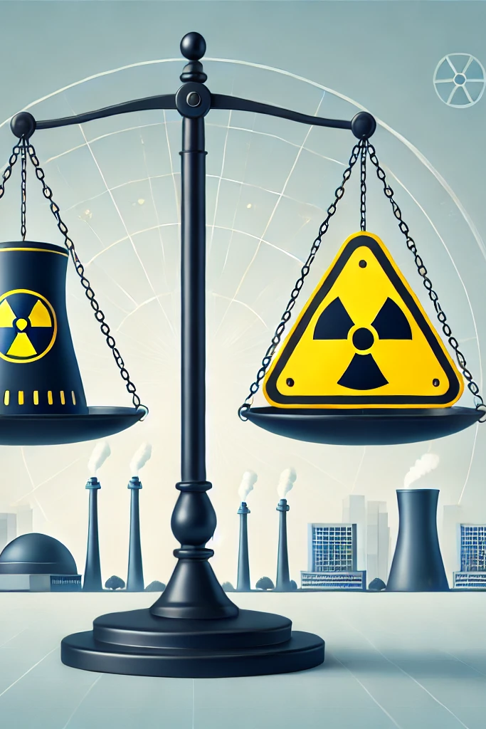
Challenges and Concerns
Safety concerns due to past nuclear incidents.
High costs and regulatory issues.
Need for advanced safety measures and innovation.
Notes:
Despite its advantages, nuclear energy comes with challenges. Safety remains a public concern, given past incidents like Chernobyl and Fukushima. High costs and regulatory hurdles also slow down development. However, with new safety measures and technological advancements, nuclear energy is becoming a more attractive option for industries seeking stable power.

Slide 7
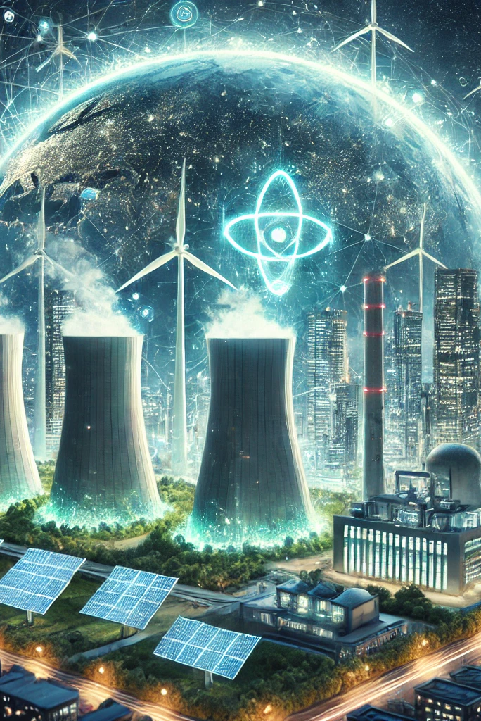
Conclusion
Tech industry requires sustainable energy solutions.
Nuclear power offers reliability and low-carbon benefits.
Companies like Microsoft are leading the transition.
The future of tech and energy is evolving together.
Notes:
The tech industry’s shift toward nuclear energy is a game-changer. As AI and cloud services grow, companies must ensure they have sustainable and reliable energy sources. Nuclear power, despite its challenges, offers a promising solution. With major players like Microsoft leading the way, we may see a new era where technology and nuclear energy work hand in hand to power the future.
Thank you. I’m happy to take any questions.

